Slide 1
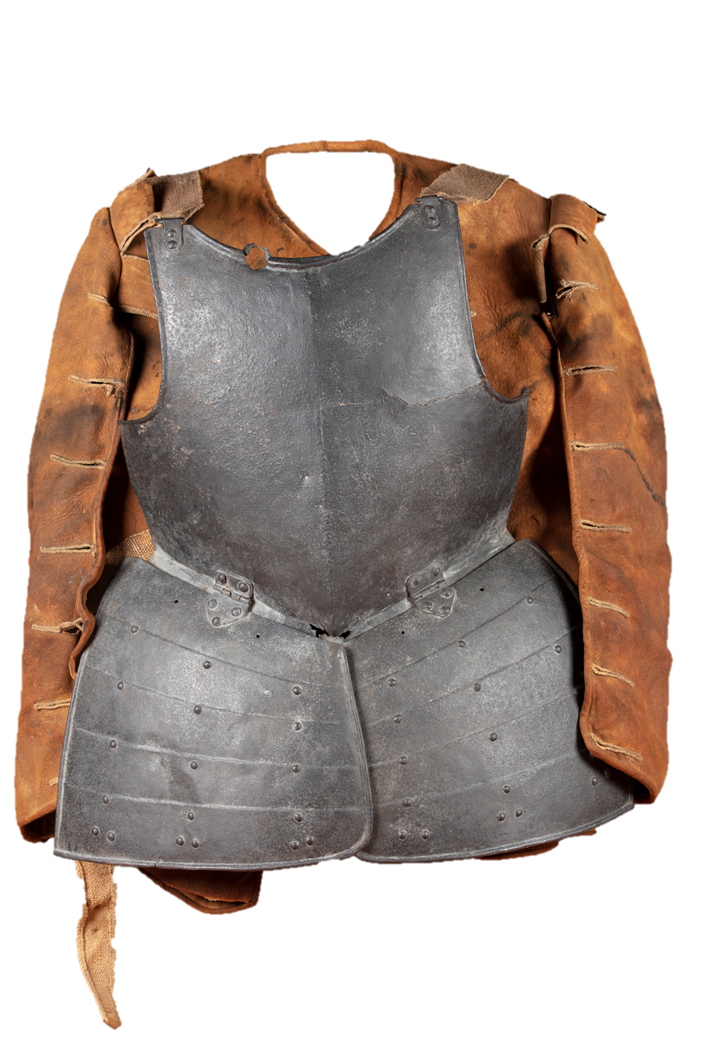



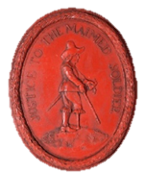
Fight a battle
Find a battlefield
Solve a mystery
Meet some soldiers
Soldiers

Slide 2
Find the Battlefield!
Developed in collaboration with The Battlefields Trust
Soldiers

Slide 3
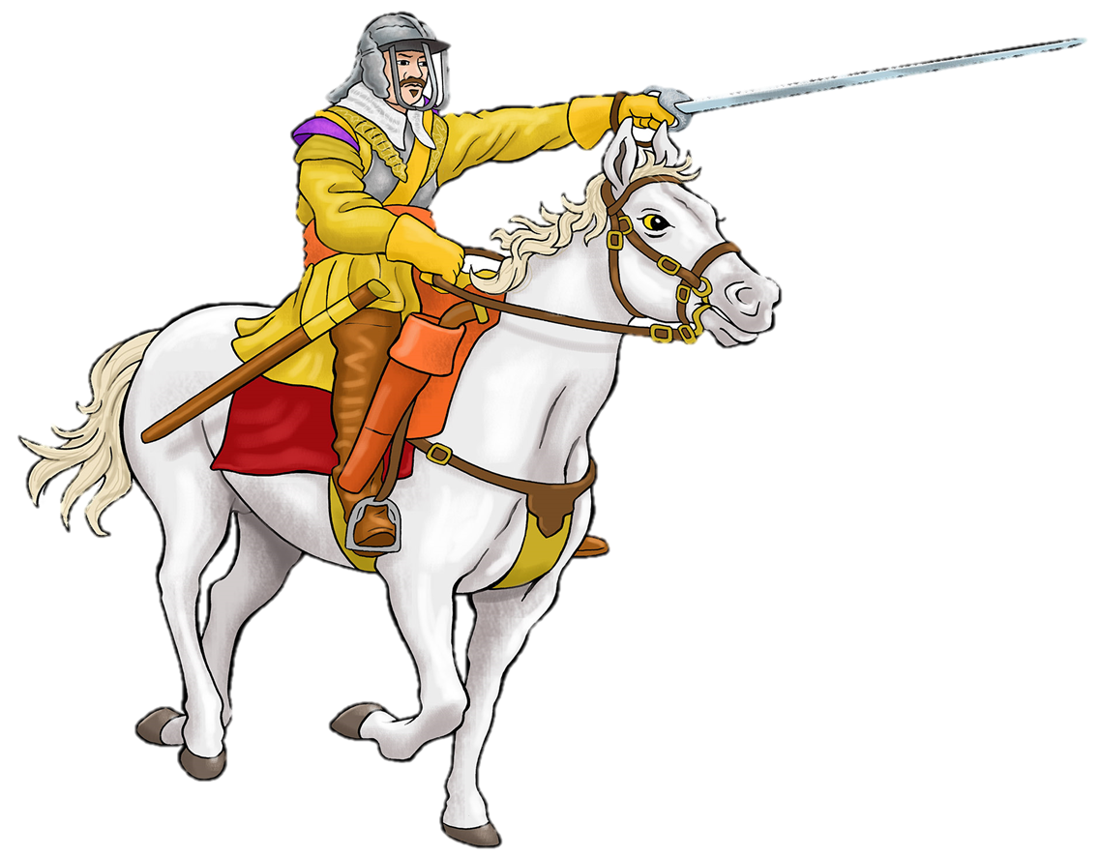
Now you know what happened at the battle of Gainsborough.
But where in Gainsborough did the battle take place?
How can historians find out what happened where in the past?

Slide 4
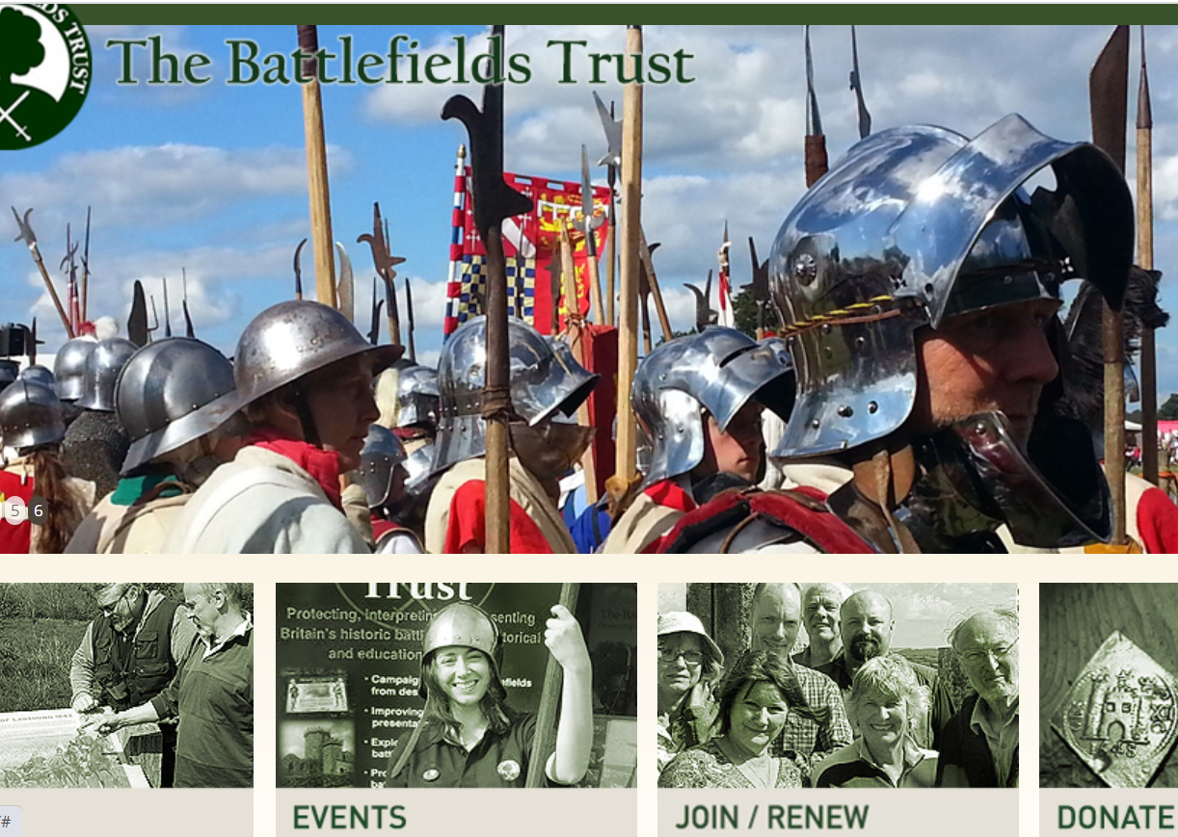
The Battlefields Trust want to put the Gainsborough Battlefield on their battle map.
They need historians to help them find out where the battle was fought.
The Battlefields Trust would like to put the this Civil War battlefield onto their map.
Can you help them find it?

Slide 5
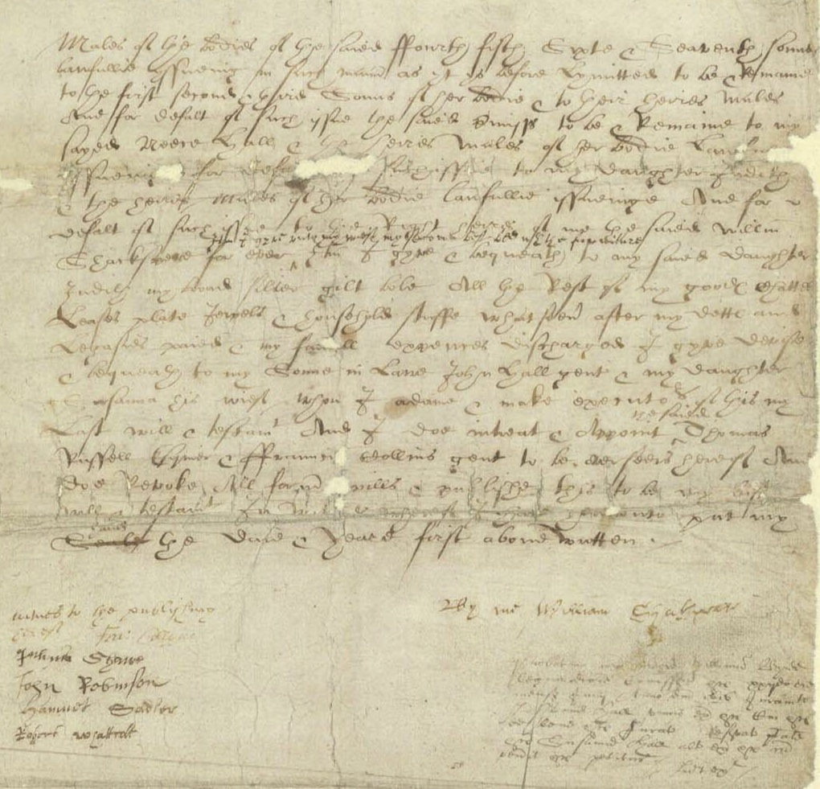
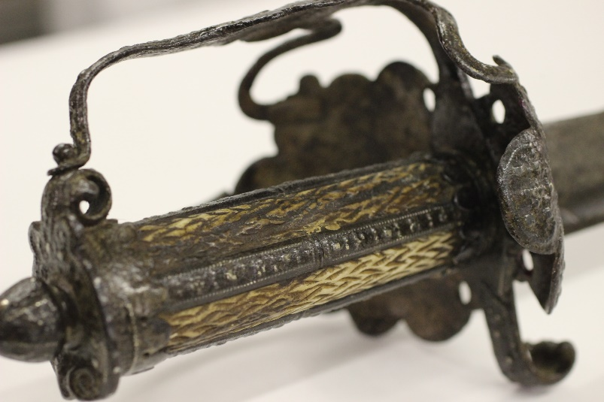
You are going to work as historians to help The Battlefields Trust
Historians use sources to help them understand what happened in the past.
You are going to use three different sources to help you decide where this battle took place
Written accounts
Objects left behind
Map clues

Slide 6
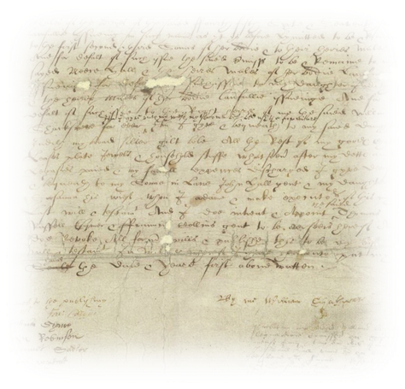
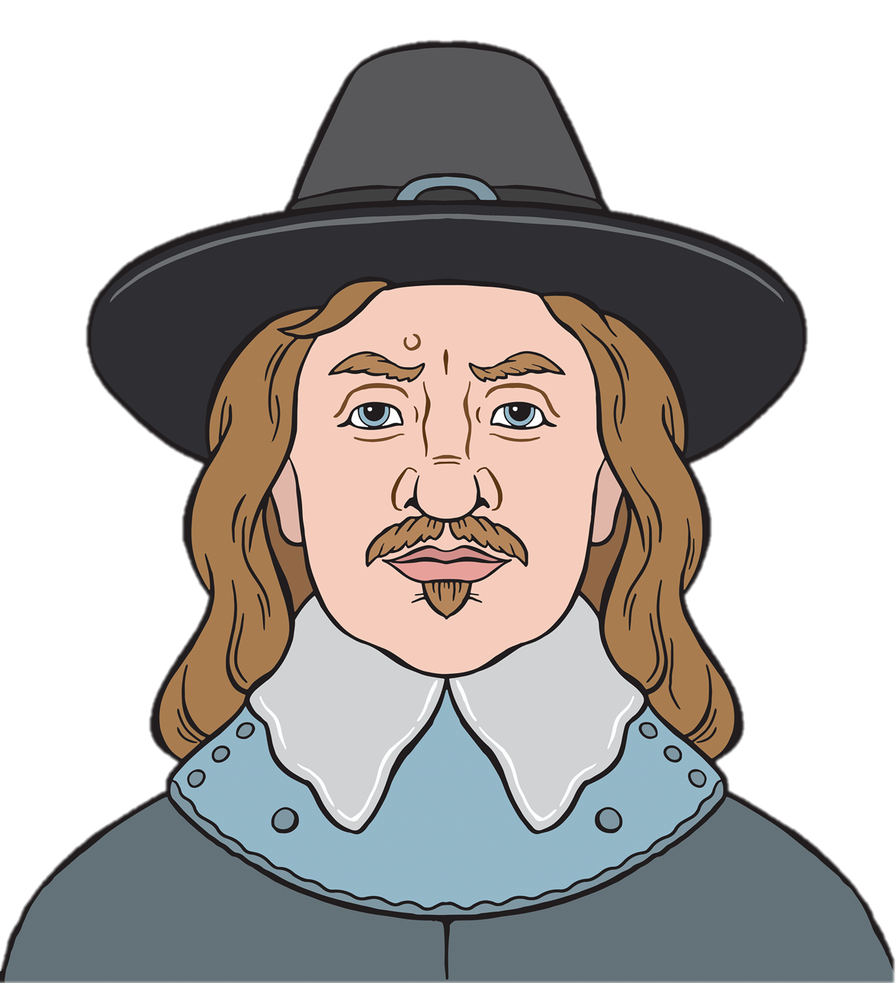
Written accounts
Oliver Cromwell told the story of what happened at the battle of Gainsborough.
Read and listen to what he said.
Can you find any clues about where he fought the battle?

Slide 7

Source 1
Click here to listen
‘..about a mile and a halfe from the towne we met a forlone hope of the enemy, of neere 100 horse, our dragooneers laboured to beat them back, but not alighting of their horses, the enemy charged them, and beat some foure or five of them off their horse, our horse charged them, and made then retire unto their maine body: We advanced, and came to the bottome of a steepe hill, up on which the enemy stood, we could not well get up but by some tracks, which our men assaying to do, the body of the enemy endeavoured to hinder’
British Library Thomason Tracts, E.63[12], A Copy of a Letter written by Colonel Cromwell, London, 1643, pp.1-2

Slide 8
Source 1
Click here to listen
About a mile and half from the town we met an advance party of about 100 cavalry soldiers. Our dragoons tried to force them back, but the enemy charged them and four or five of our soldiers were beaten off their horses. Our cavalry charged and pushed them back into their main army. We advanced and came to the bottom of a steep hill on which the enemy stood. It was difficult to get up the hill, but our soldiers tried to do this by following some tracks. The enemy tried hard to stop them.
Letter written by Oliver Cromwell

Slide 9
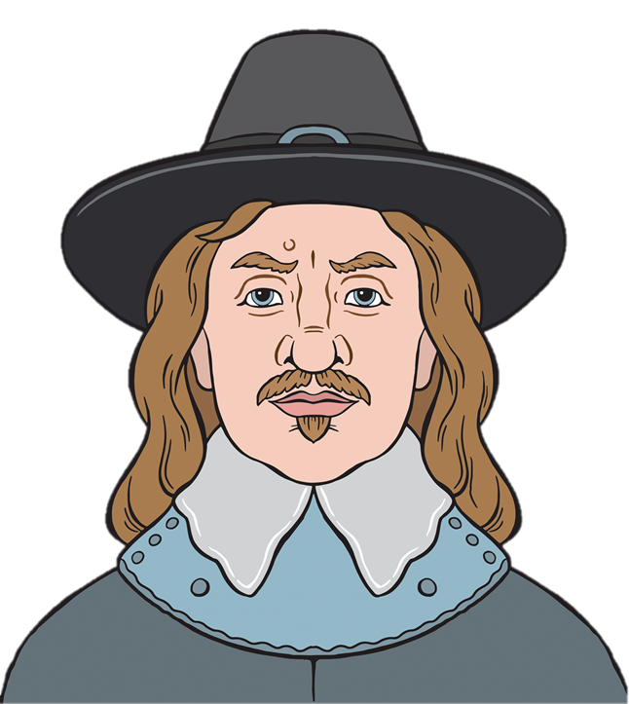
Source 2
‘We advanced still towards the Enemy, all along under the cony-warren, which was upon a high hill above Gainsborough. The Lincoln troops had the van, two Northampton, and three small troops of Nottingham the battle, and Colonel Cromwell the rear; the Enemy in the meantime with his body keeping the top of the Hill. Some of the Lincoln Troops began to advance up the hill; which were opposed by a force of the Enemy; but our men repelled them, until all our whole body was got up the Hill. The Enemy kept his ground; which he chose for his best advantage, with a body of Horse of about Three Regiments of Horse, and a reserve behind them consisting of General Cavendish his Regiment, which was a very full regiment. We presently put our Horse in order; which we could hardly do by reason of the cony-holes and the difficult ascent up the Hill’
Thomas Carlyle, Oliver Cromwell’s Letters and Speeches, Vol V, Appendix V, London, 1872, p.166
Click here to listen

Slide 10
Source 2
We advanced towards the enemy along the rabbit warren which was on a high hill above Gainsborough. Our army had the Lincoln troops at the front, two troops from Northampton and three small troops from Nottingham in the middle and Colonel Cromwell’s troop was at the back. The enemy stayed at the top of the hill. We began to advance up the hill. The enemy opposed us but we fought them off until our whole army reached the top. The enemy held their ground which gave them the advantage. They had three cavalry regiments and another very large regiment held back in reserve commanded by General Cavendish. We formed up our cavalry ready to fight which was difficult because of all the rabbit holes and the difficult climb up the hill.
Click here to listen

Slide 11
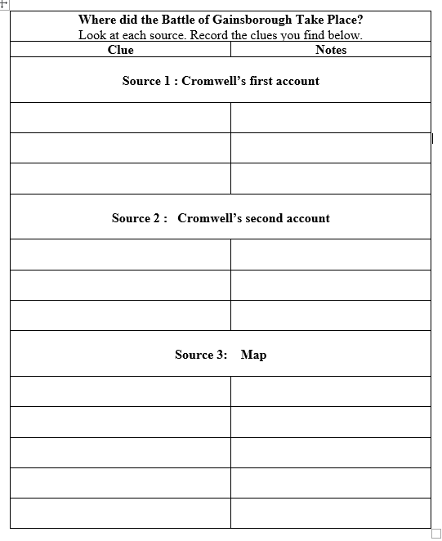
What clues about where the battle was fought can you find in these sources?
Note the clues down on your sheet.

Slide 12
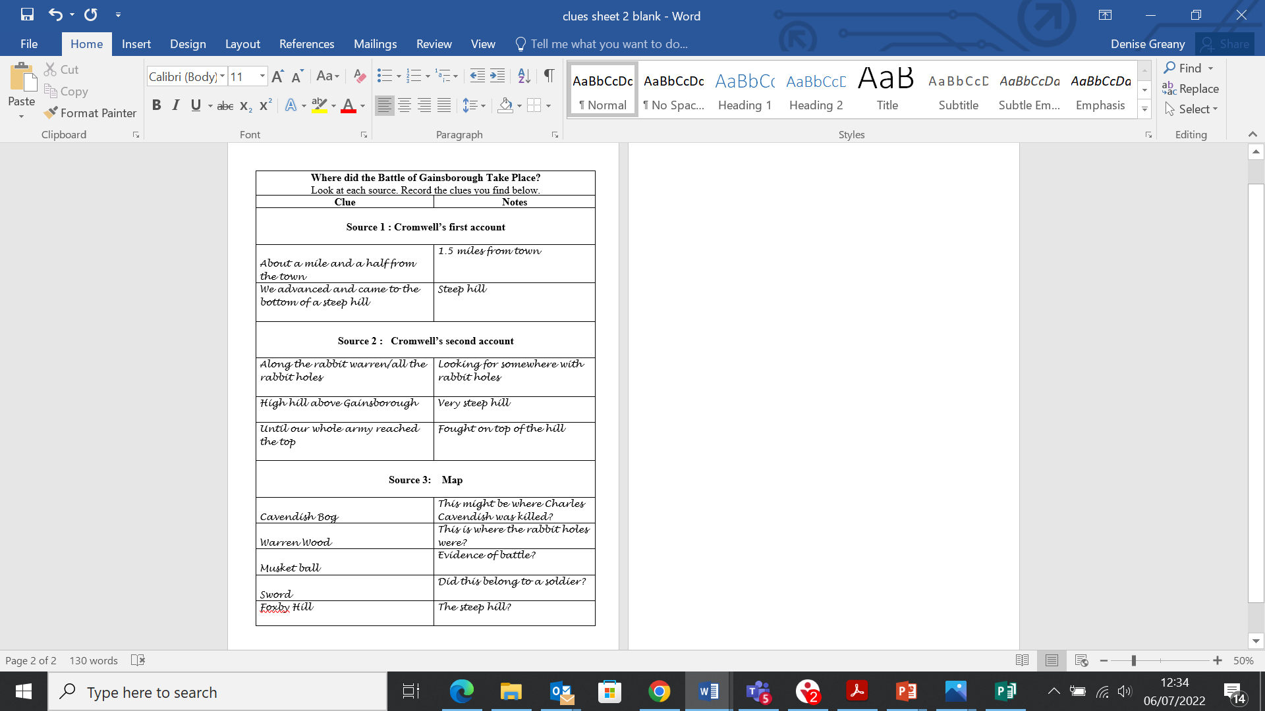
What clues have we found so far about the location of the battlefield?

Slide 13
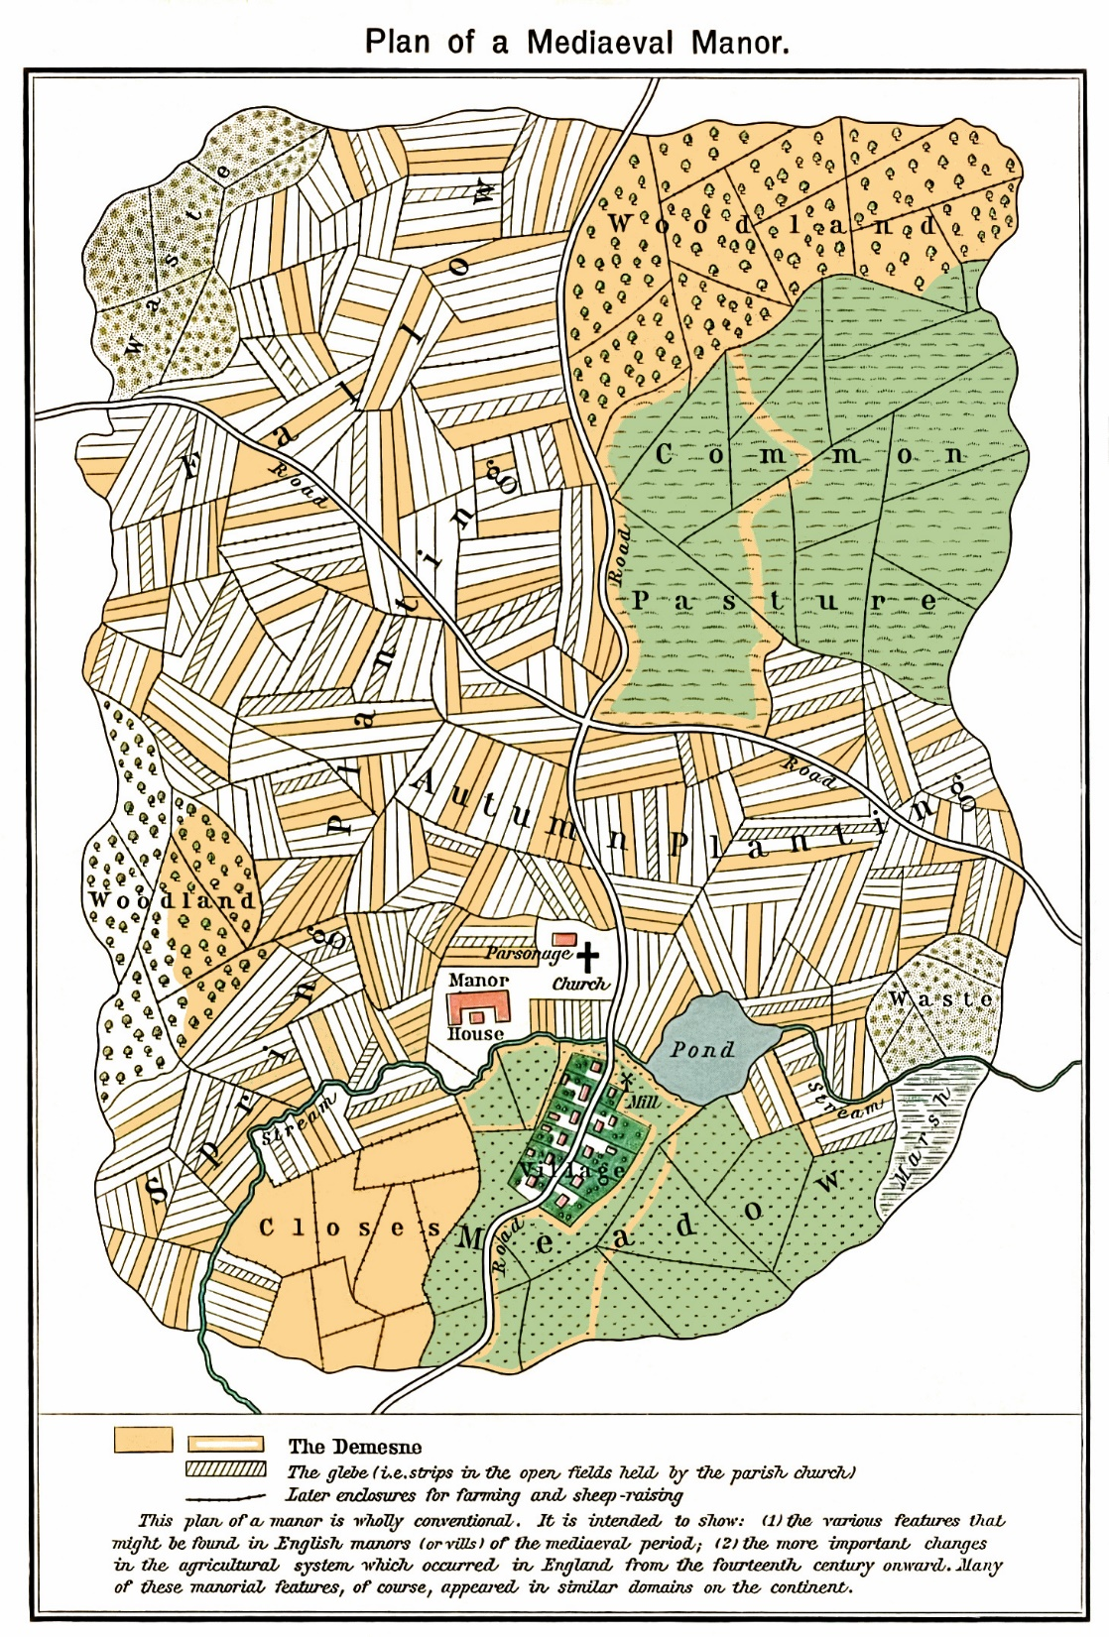
Landscape in the Past
In medieval England the land around a manor house was divided into strips.
Some of these strips belonged to the Lord of the manor (the demesne land).
The rest of these strips were shared out between the people of the village. Everyone had a share of good and bad land.
There were also common fields that people could use to graze their animals or gather firewood.

Slide 14
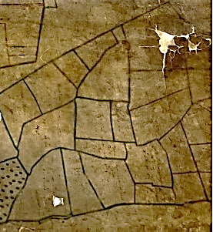
In the seventeenth century, this system began to change in some places.
Enclosure began. This meant that some fields were hedged and peasants lost some of their rights and privileges.
This is a seventeenth-century map of Gainsborough. These fields were now enclosed by hedges.

Slide 15
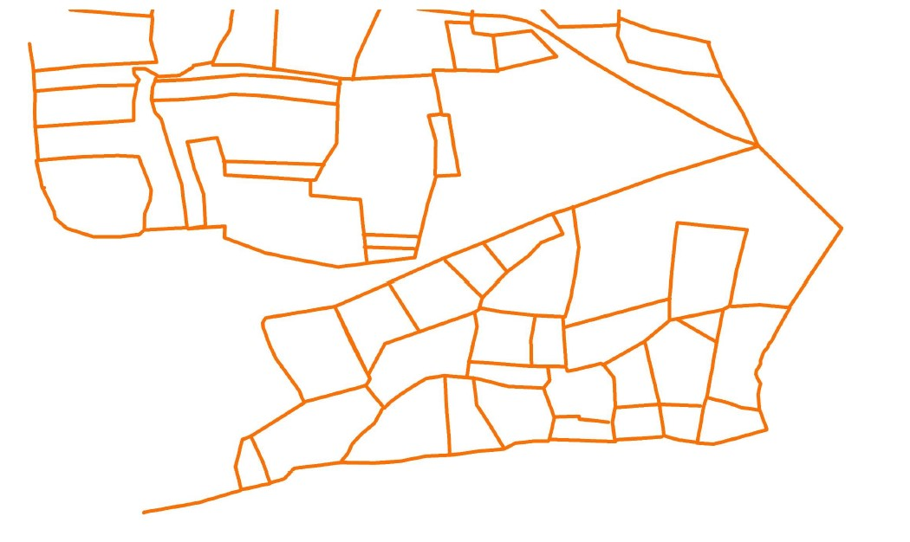
Here is the outline of the fields and hedges in seventeenth-century Gainsborough

Slide 16
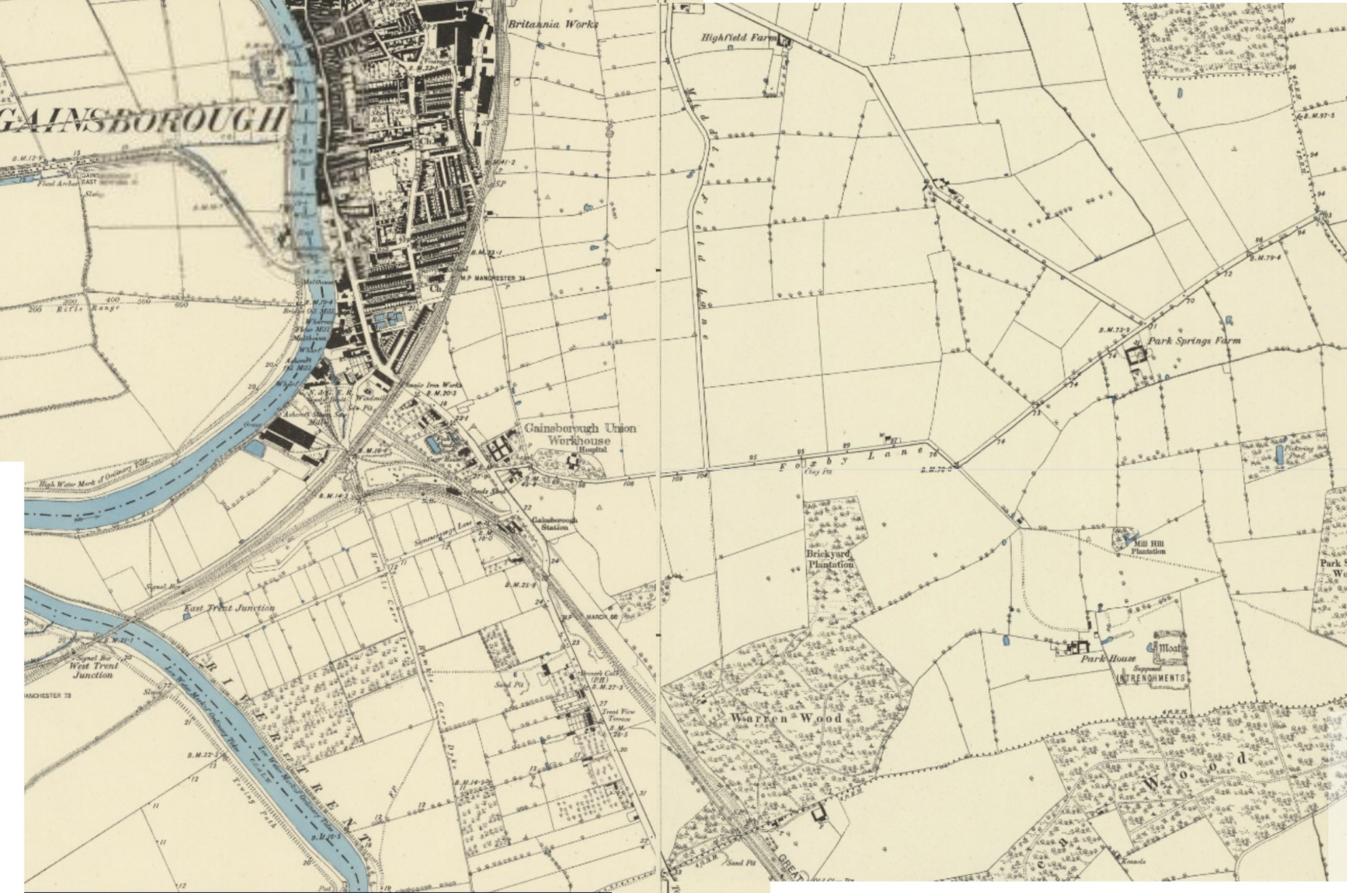
This is a map of Gainsborough in 1880.
We can imagine what the land around Gainsborough was like in the seventeenth century by laying the enclosure map over this map

Slide 17
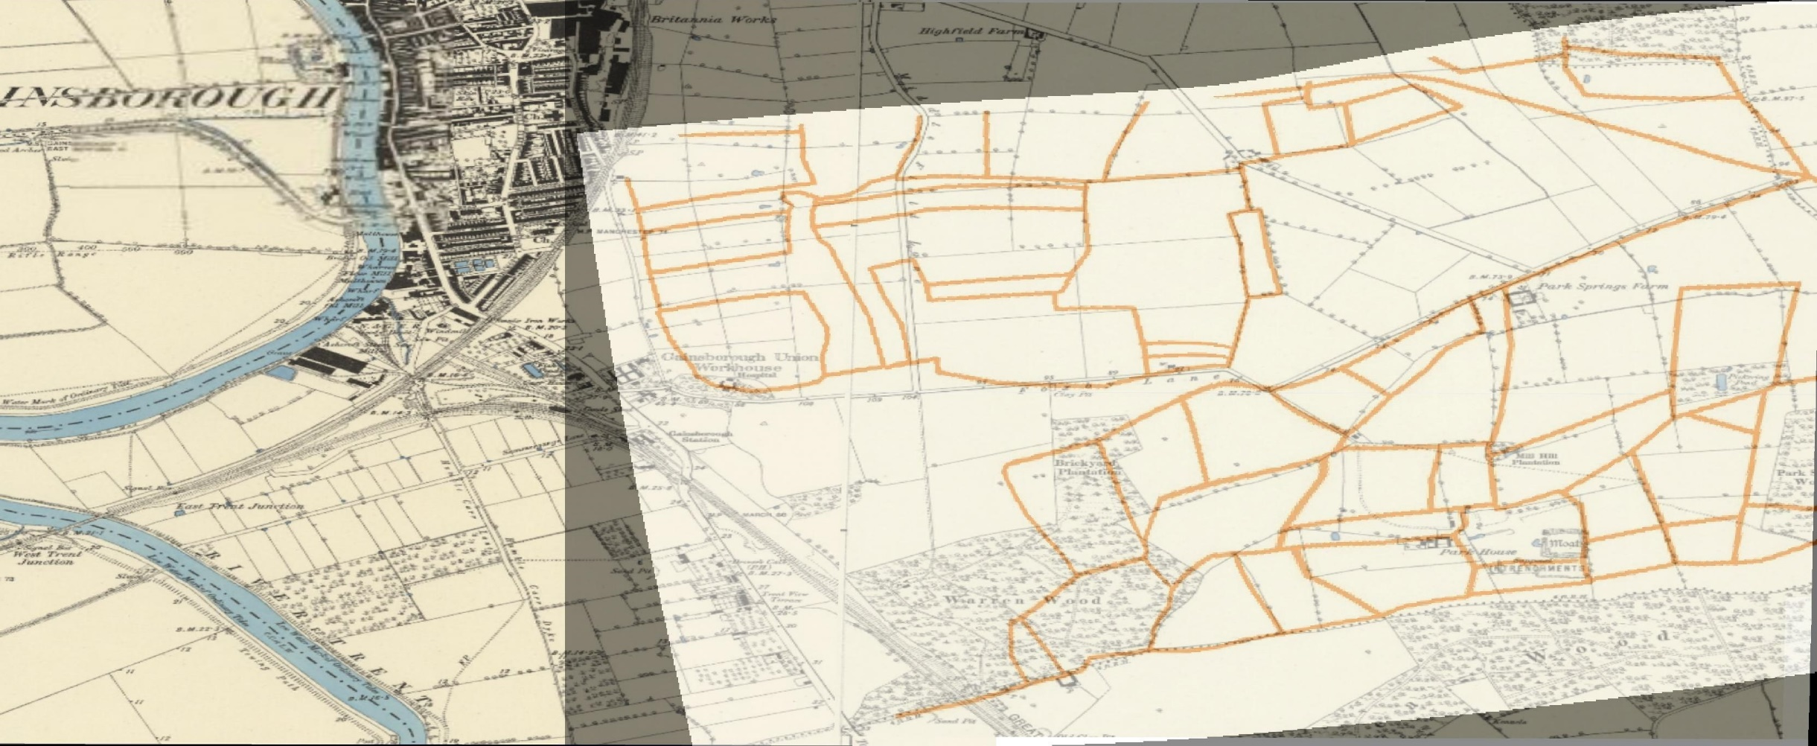
Like this..

Slide 18
Foxby Hill

Slide 19
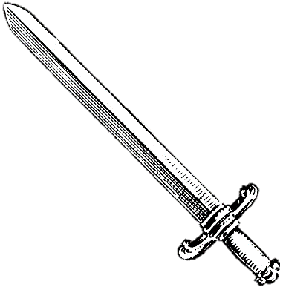
Sword found here
Musket Balls found here
Foxby Hill

Slide 20
What clues can you find on your map?
Fill in the rest of your sheet
Look for evidence in
Objects that have been found in the ground (archaeology)
Place Names
Landscape features

Slide 21
Do these clues help you to find the battlefield? Where do you think it might have been?

Slide 22
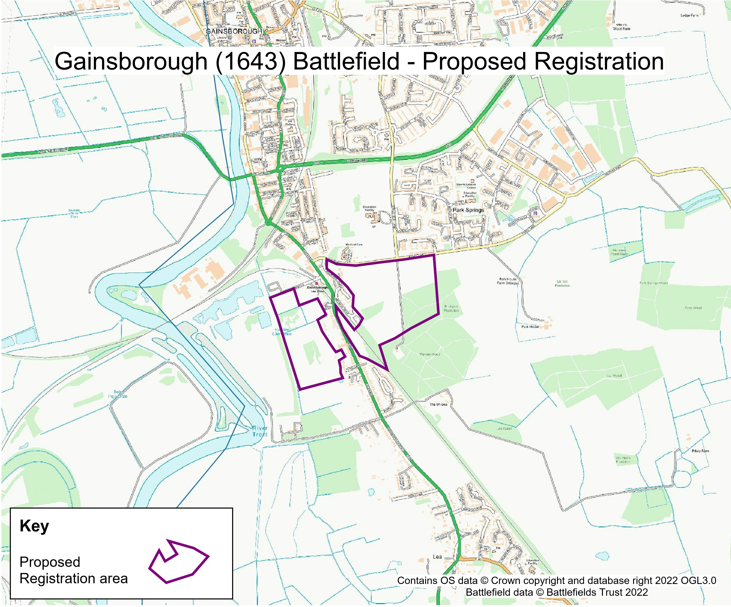
The Battlefields Trust would like to apply to Historic England to register Gainsborough Battlefield in this location, based on historical evidence.
You can help them by writing a letter to Historic England, persuading them that the battle took place here.
Use the writing frame and your clues sheet to help you.

